Slide 1
Logic
Lecture 2
Notes:
1

Slide 2
Limitation of Propositional Logic
Propositional logic: the world is described in terms of elementary propositions and their logical combinations
Elementary statements:
Typically refer to objects, their properties and relations.
But these are not explicitly represented in the propositional logic
Hasan is a NSU student
Hasan - object
A NSU student - a property
Objects and properties are hidden in the statement, it is not possible to reason about them
Notes:
2

Slide 3
Limitation of Propositional Logic
Statements that must be repeated for many objects
Example
If Hasan is a CSE GUB graduate then Hasan has passed CSE105
Translation
Hasan is a CSE GUB graduate → Hasan has passed CSE105
Solution: make statements with variables
If x is a CSE GUB graduate then x has passed CSE105
x a CSE GUB graduate → x has passed CSE105
Notes:
3

Slide 4
Limitation of Propositional Logic
Statements that define the property of the group of objects
Example
Some of the CSE graduates graduate with honors.
Solution: make statements with quantifiers
- Universal quantifier –the property is satisfied by all members of the group
– Existential quantifier – at least one member of the group satisfy the property
Notes:
4

Slide 5
Predicate Logic
Remedies the limitations of the propositional logic
• Explicitly models objects and their properties
• Allows to make statements with variables and quantify them
Basic building blocks of the predicate logic:
• Constant –models a specific object
Examples: “Hasan”, “Khulna”, “7”
• Variable – represents object of specific type
(defined by the universe of discourse)
Examples: x, y
(universe of discourse can be people, students, numbers)
• Predicate - Represents properties of objects
Examples: Red(car23), student(x), married(John,Ann)
Notes:
5

Slide 6
Assigning value to Predicate
Predicate - Represents properties of objects
A predicate P(x) assigns a value true or false to each x depending
on whether the property holds or not for x.
x is a prime number (universe of discourse is integers)
What are the truth values of:
• P(2) T
• P(3) T
• P(4) F
• P(5) T
All statements P(2), P(3), P(4), P(5) are propositions.
Is P(x) a proposition? No. Many substitutions are possible.
Notes:
6

Slide 7
Assigning value to Predicate
Predicates can have more arguments which represent the
relations between objects
Example:
• Let Q(x,y) denote ‘x+5 >y’
– Is Q(x,y) a proposition? No!
– Is Q(3,7) a proposition? Yes
– What is the truth value of:
– Q(3,7) T
– Q(1,6) F
- Q(3,y) may be T or F. not a proposition.
Notes:
7

Slide 8
Predicate is not proposition
Important:
• statement P(x) is not a proposition since there are many objects it can be applied to
This is the same as in propositional logic …
… But the difference is:
• predicate logic allows us to explicitly manipulate and substitute for the objects
• Predicate logic permits quantified sentences where variables are substituted for statements about the group of objects
Notes:
8

Slide 9
Quantified Statements
Predicate logic lets us to make statements about groups of objects
• To do this we use special quantified expressions
Two types of quantified statements:
• universal
Example: ‘ all CSE GUB graduates have to pass CSE 105”
– the statement is true for all graduates
• existential
Example: ‘Some CSE GUB students graduate with honor.’
– the statement is true for some people
Notes:
9

Slide 10
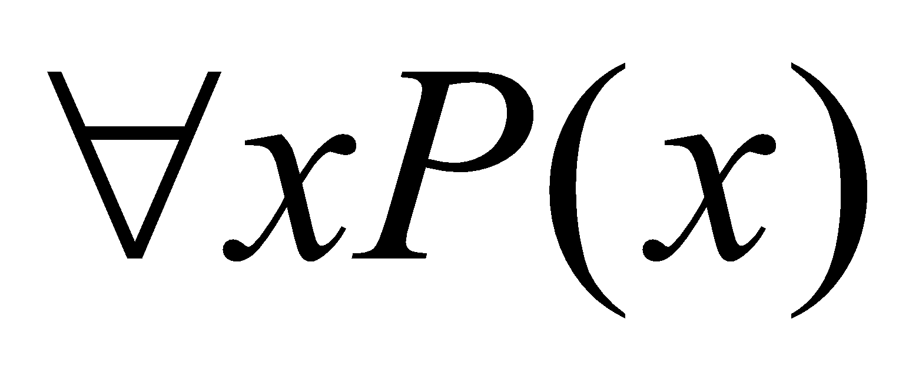
Universal Quantifier
Defn: The universal quantification of P(x) is the proposition:
"P(x) is true for all values of x in the domain of discourse."
The notation denotes the universal quantification of P(x), and is expressed as for every x, P(x).
Example:
• Let P(x) denote x > x - 1.
• What is the truth value of ?
• Assume the universe of discourse of x is all real numbers.
• Answer: Since every number x is greater than itself minus 1.
Therefore, is true.
Notes:
10

Slide 11
Universally Quantified Statement
Predicate logic lets us make statements about groups of objects
Universally quantified statement
• CSE-major(x) → Student(x)
– Translation: “if x is a CSE-major then x is a student”
– Proposition: no.
•
– Translation: “(For all people it holds that) if a person is a
CSE-major then s/he is a student.”
– Proposition: yes.
Notes:
11

Slide 12
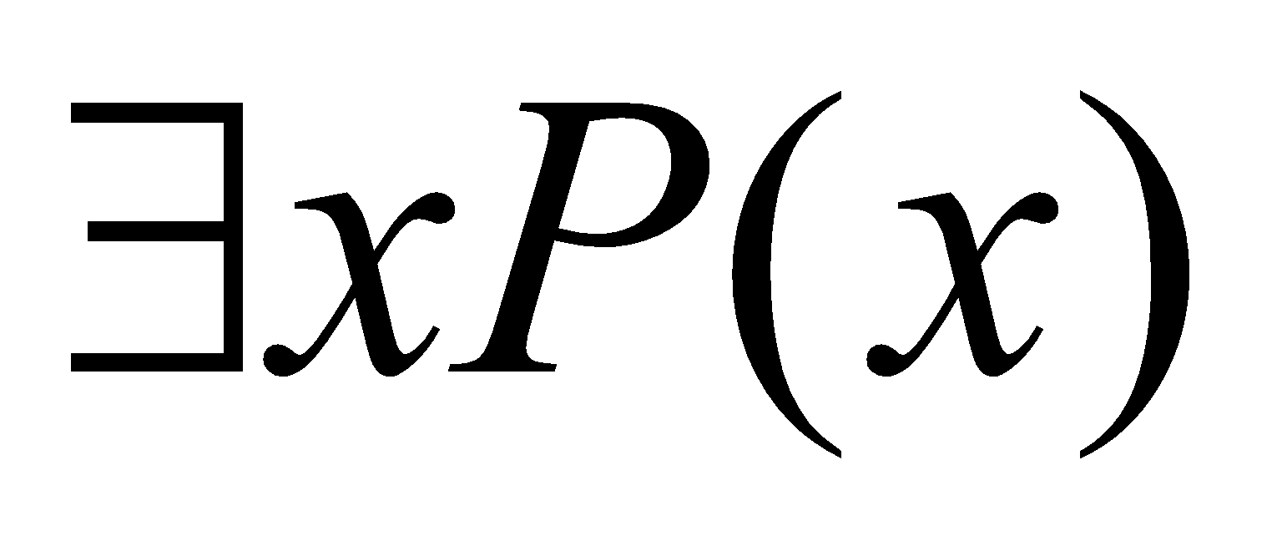
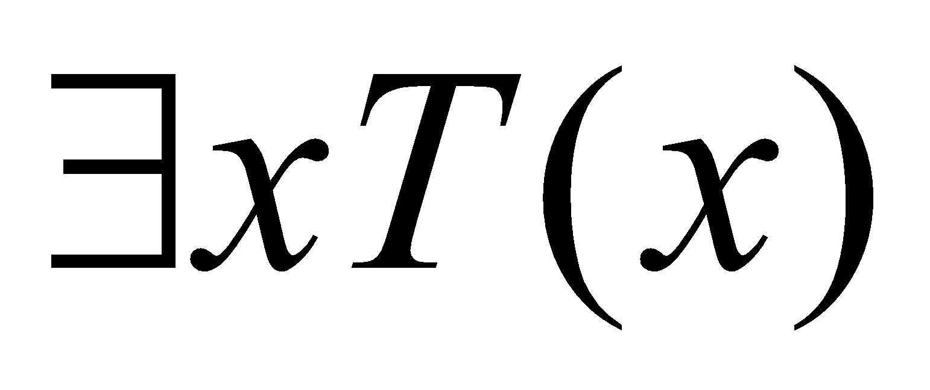
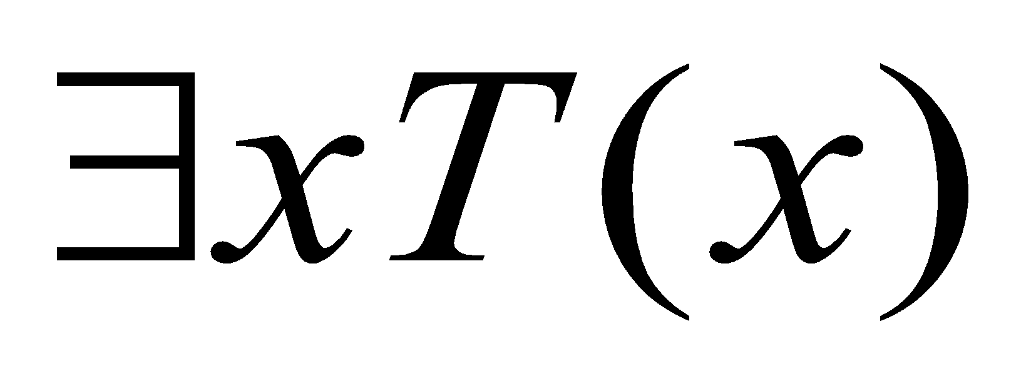
Existential Quantifier
Definition: The existential quantification of P(x) is the
proposition
"There exists an element in the domain (universe) of
discourse such that P(x) is true."
The notation:
Example 1:
• Let T(x) denote x > 5 and x is from Real numbers.
• What is the truth value of ?
• Answer:
• Since 10 > 5 is true. Therefore, it is true that
Notes:
12

Slide 13
Quantified statements
Statements about groups of objects
Example:
• CSE-NSU-graduate (x) ˄ Honor-student(x)
– Translation: “x is a CSE-GUB-graduate and x is an honor student”
– Proposition: no.
•
– Translation: “There is a person who is a CSE-GUB-graduate and who is also an honor student.”
– Proposition: ? yes
Notes:
13

Slide 14
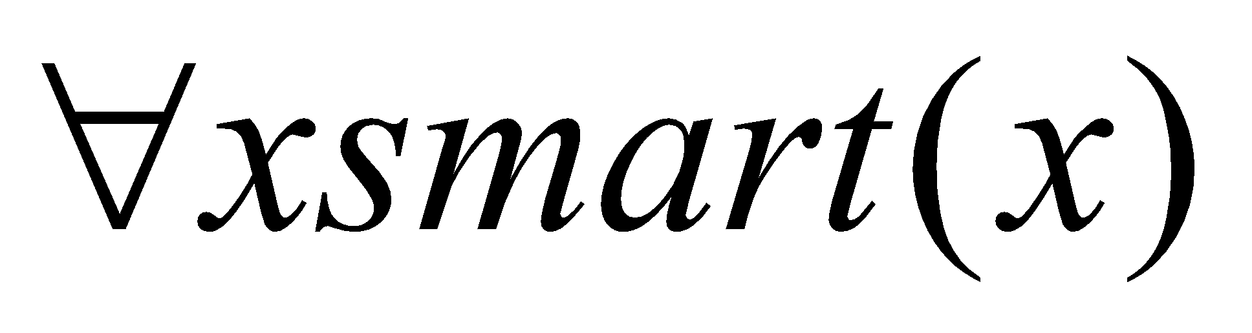
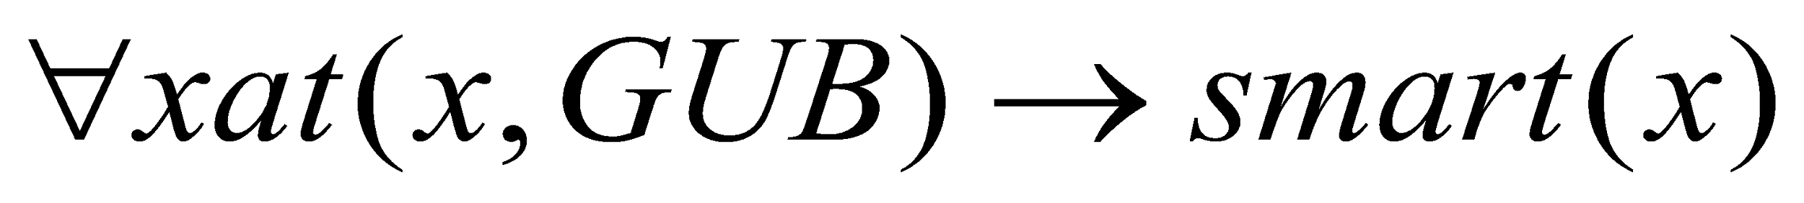
Translation with Quantifier
Sentence:
• All NSU students are smart.
• Assume: the domain of discourse of x are NSU students
• Translation:
• Assume: the universe of discourse are students (all students):
•
• Assume: the universe of discourse are people:
•
Notes:
14

Slide 15
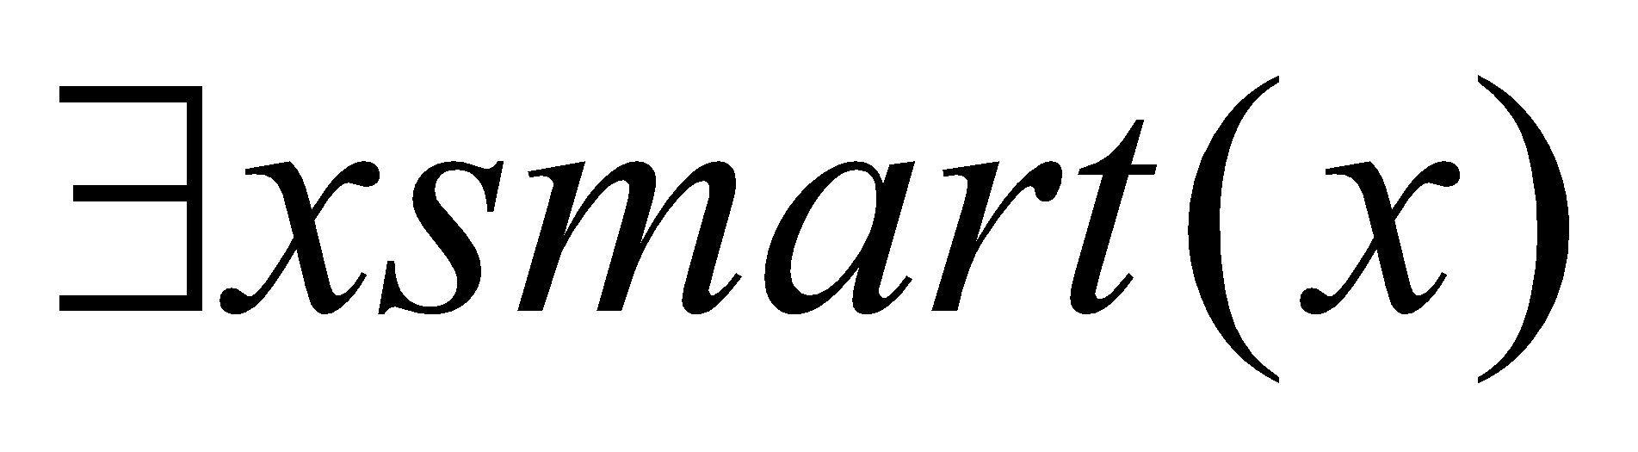
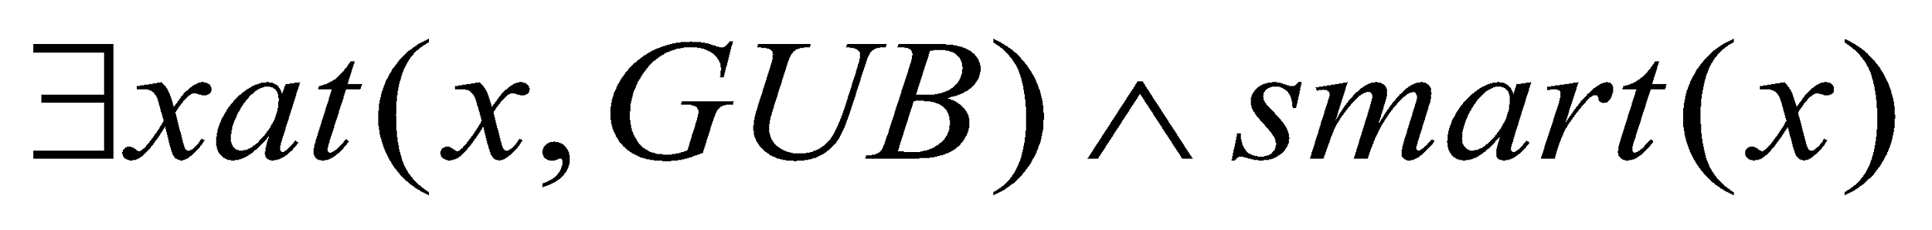
Translation with Quantifier
Sentence:
• Someone at GUB is smart.
• Assume: the domain of discourse are all GUB affiliates
• Translation:
• Assume: the universe of discourse are people:
•
Notes:
15

Slide 16
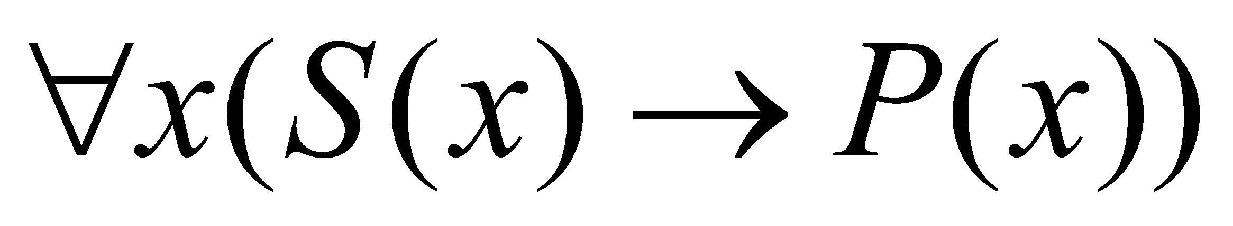
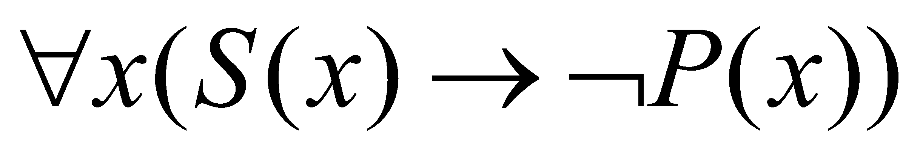
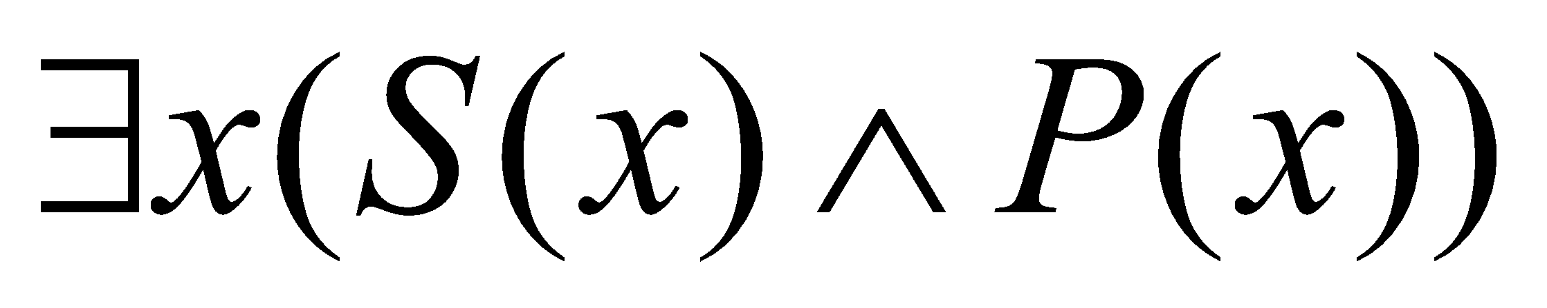
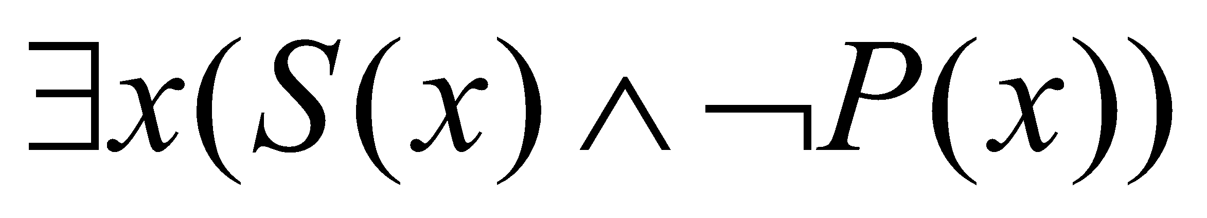
Translation with Quantifier
Assume two predicates S(x) and P(x)
Universal statements typically tie with implications
• All S(x) is P(x)
–
• No S(x) is P(x)
–
Existential statements typically tie with conjunctions
• Some S(x) is P(x)
–
• Some S(x) is not P(x)
–
Notes:
16

Slide 17
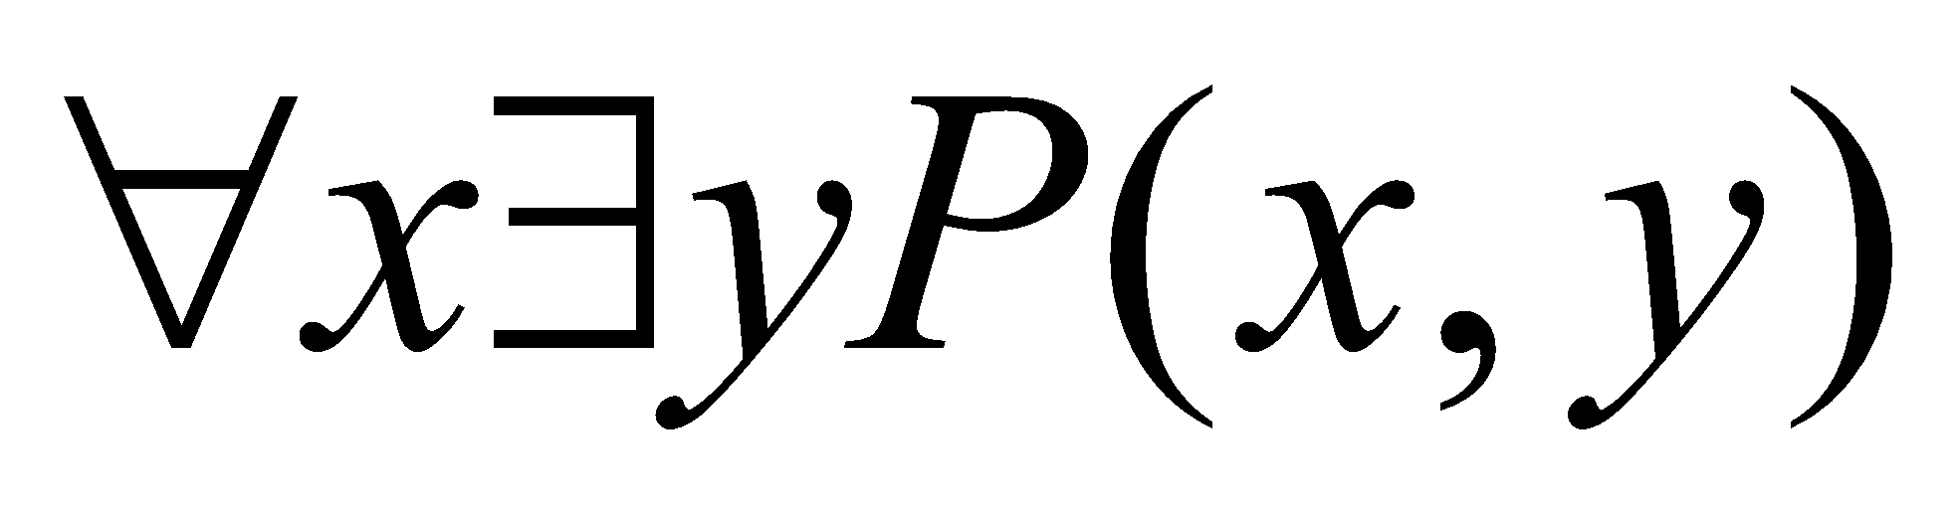
Nested Quantifier
More than one quantifier may be necessary to capture the
meaning of a statement in the predicate logic.
Example:
• Every real number has its corresponding negative.
• Translation:
– Assume:
• a real number is denoted as x and its negative as y
• A predicate P(x,y) denotes: “x + y =0”
• Then we can write:
Notes:
17

Slide 18
Nested Quantifier
Everybody is somebody’s friend
F(x,y) represent "x is a friend of y".
∀𝑥 represent "for all x".
∃𝑦 represent "there exists y".
∀x∃yF(x,y)
Notes:
18

Slide 19
Nested Quantifier
You can fool some people all the time
∃x ∀t (person(x)∧time(t)⇒can_be_fooled(x,t))
You can fool all people all the time
∀x ∀t (person(x)∧time(t)⇒can−be−fooled(x,t))
You can fool all people some of the time
∀x ∃t (person(x)∧time(t)⇒can−be−fooled(x,t))
Notes:
19

Slide 20
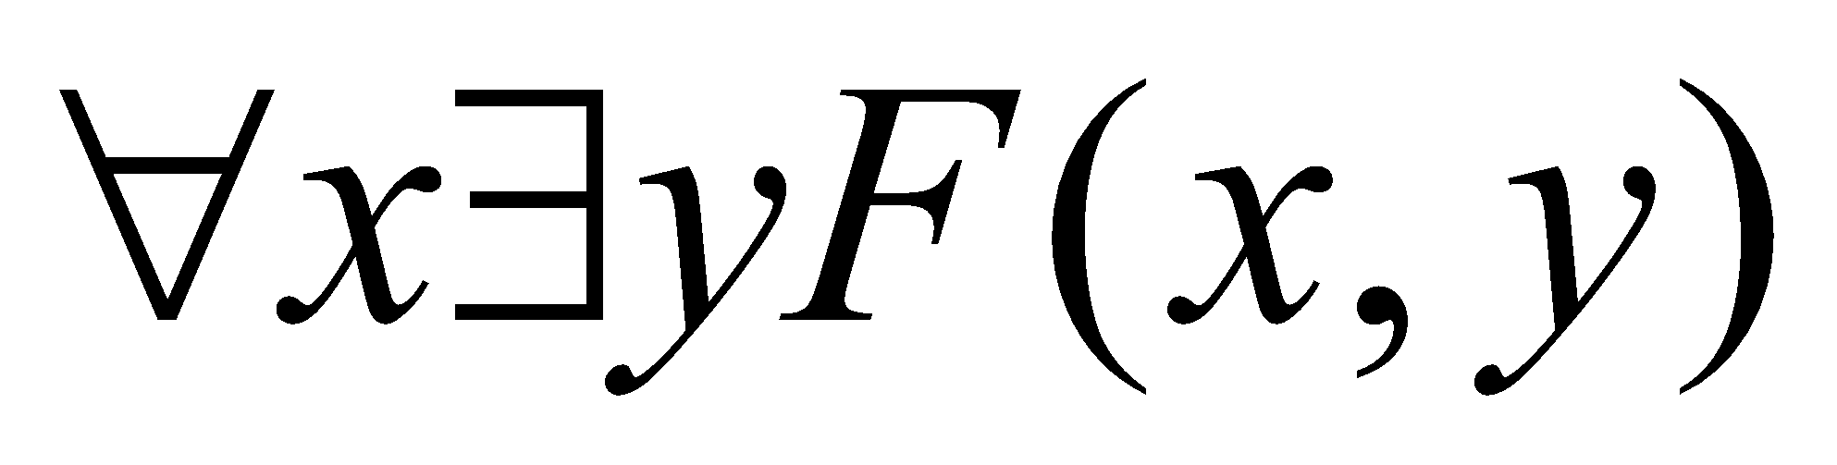
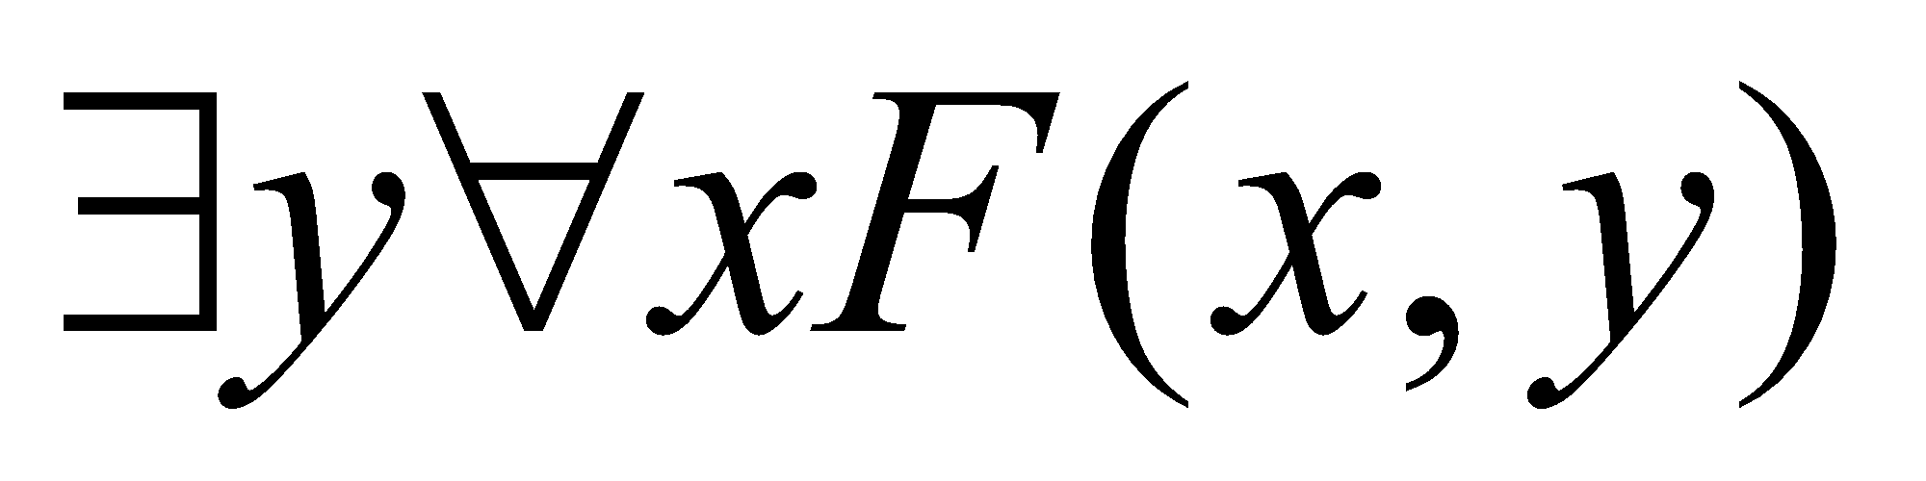
Order of Quantifier
The order of nested quantifiers matters if quantifiers are of different type
Example:
• Assume F(x,y) denotes “x is a friend of y”
• Then:
• Translates to: Everybody is a friend of somebody.
• And:
• Translates to: There is someone who is friend of everyone.
The meaning of the two is different.
Notes:
20

Slide 21
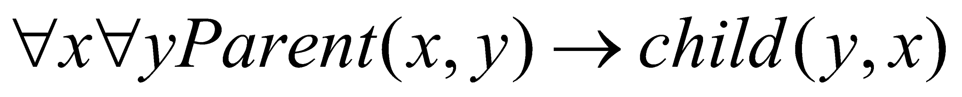
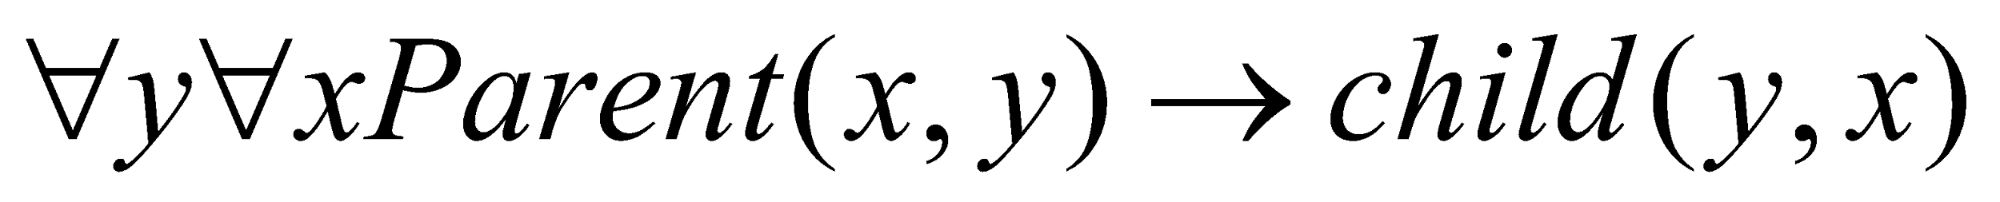
Order of Quantifier
The order of nested quantifiers does not matter if quantifiers are of the same type
Example:
• For all x and y, if x is a parent of y then y is a child of x
• Assume:
– Parent(x,y) denotes “x is a parent of y”
– Child(x,y) denotes “x is a child of y”
• Two equivalent ways to represent the statement:
Notes:
21

Slide 22
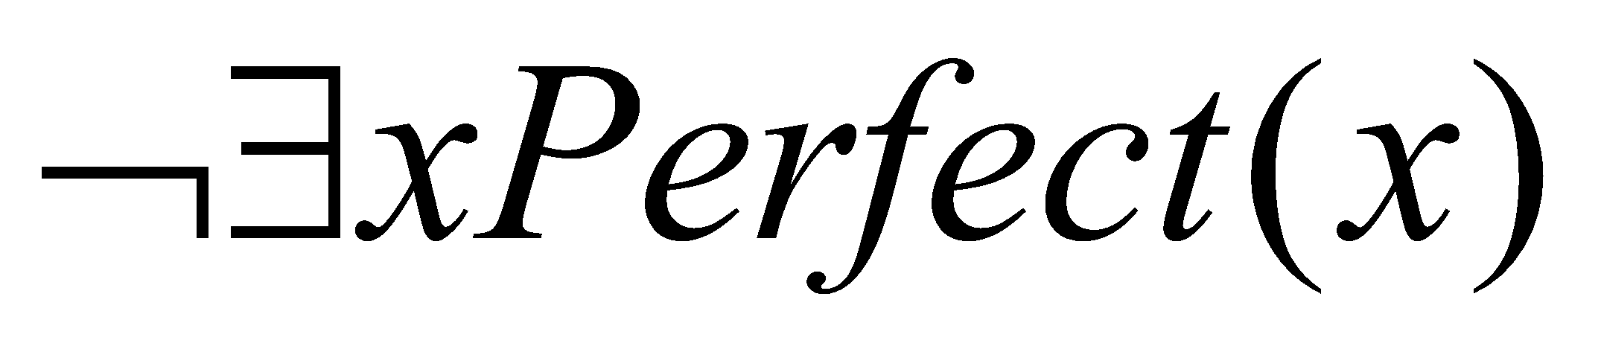
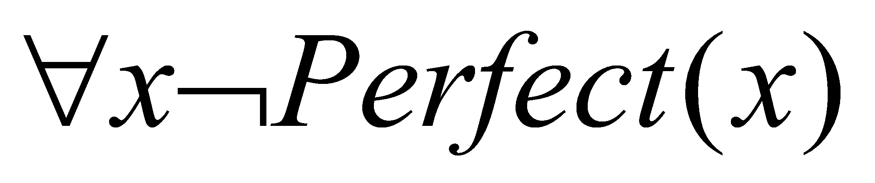
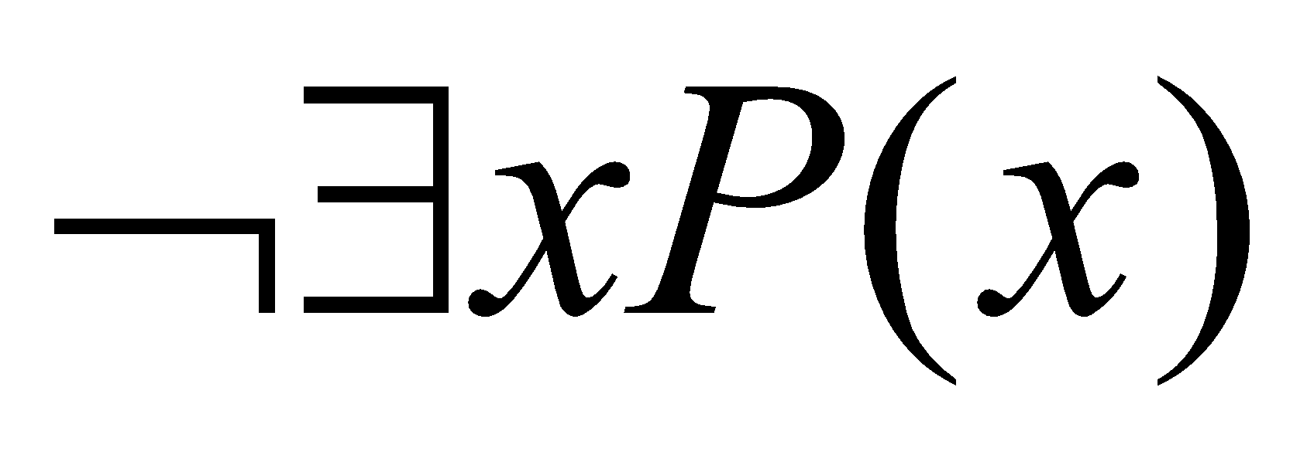
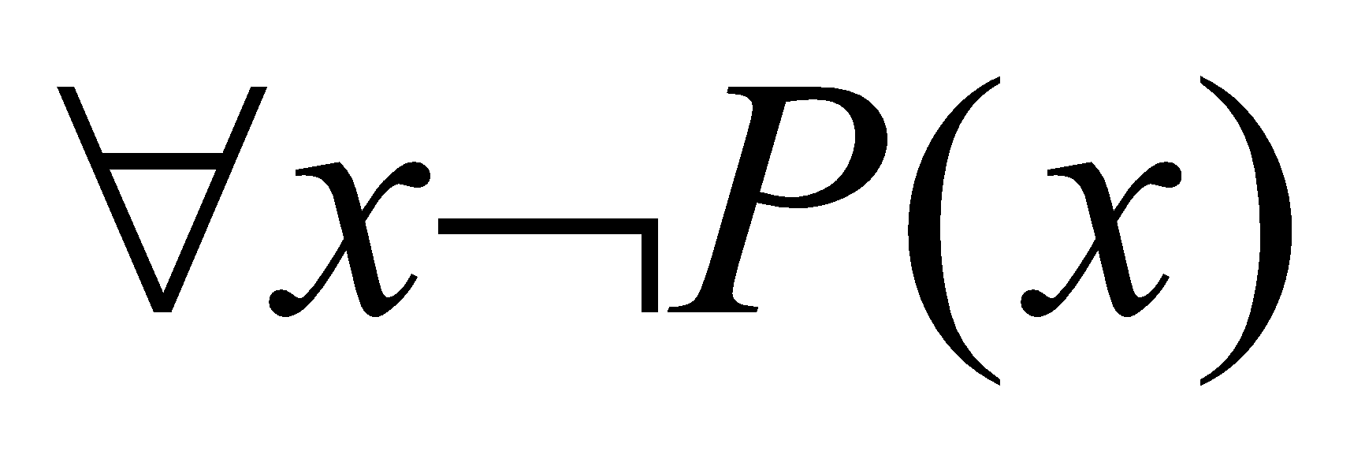
Negation of quantifiers
English statement:
• Nothing is perfect.
• Translation:
Another way to express the same meaning:
• Everything is imperfect.
• Translation:
Conclusion: is equivalent to
Notes:
22

Slide 23
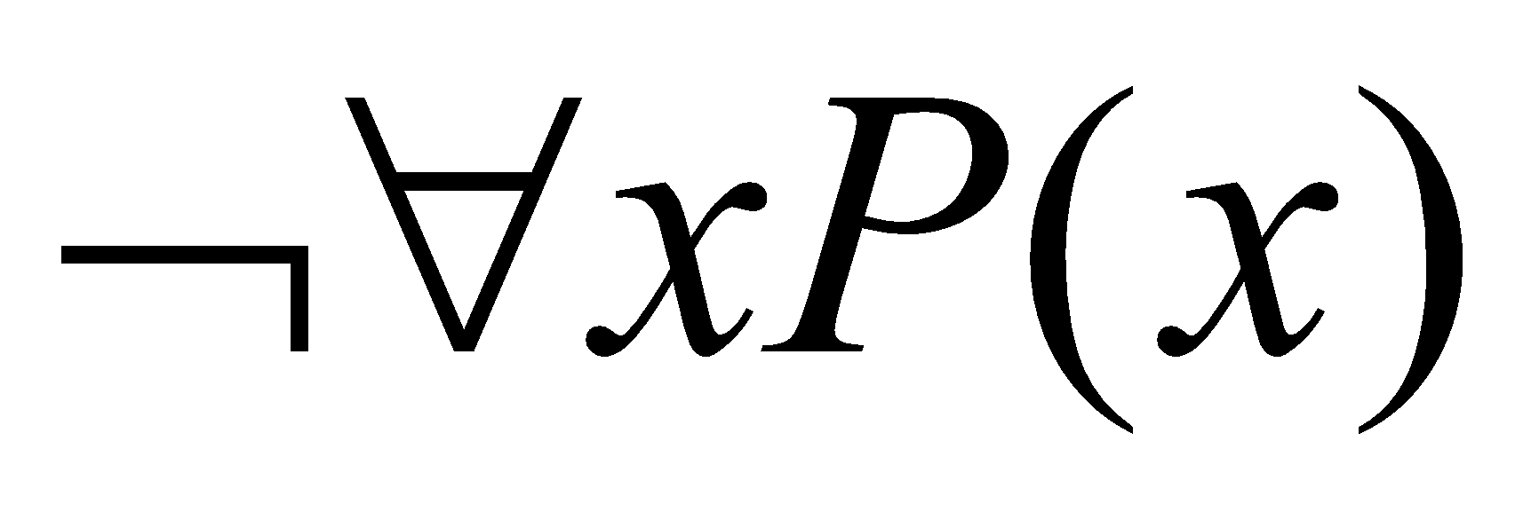
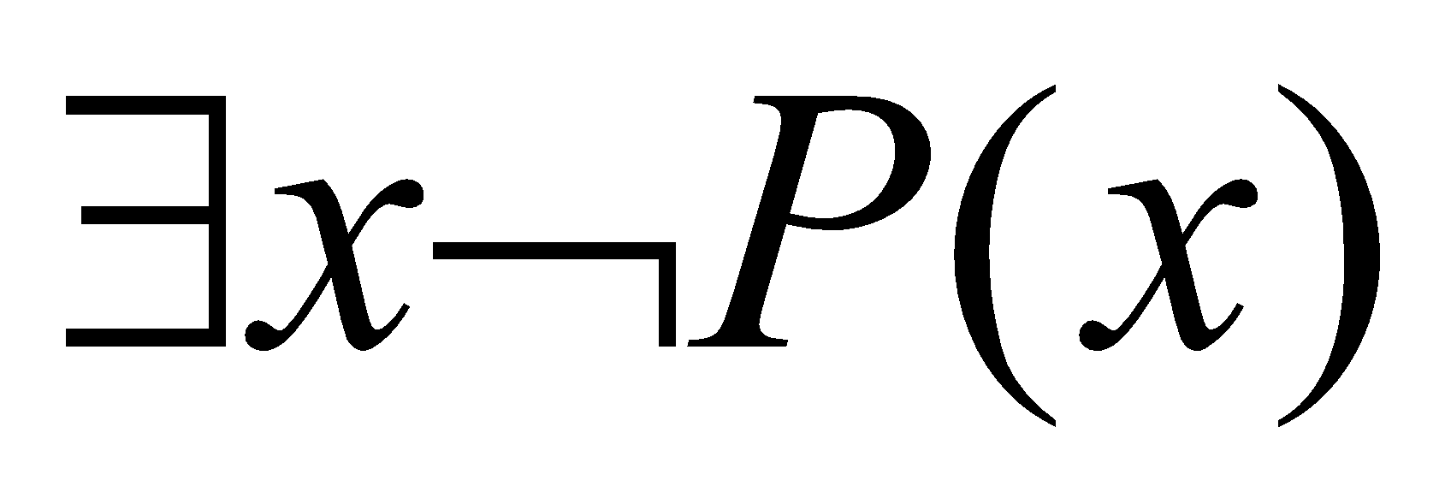
Negation of quantifiers
DeMorgan Laws for quantifiers
Negation | Equivalent
Notes:
23

Slide 24
Negation of quantifiers
¬∃ f(x) = ∀ ¬f(x)
There does not exist a person who is perfect.
¬∃x perfect(x)
All people are not perfect.
∀x¬perfect(x)
Notes:
24

Slide 25
Negation of quantifiers
∃¬f(x) = ¬∀ f(x)
There exists a person who is not honest.
Symbolically: ∃𝑥 ¬ℎ𝑜𝑛𝑒𝑠𝑡(𝑥)
This is equivalent to: "It is not true that all people are honest.
Symbolically: ¬∀𝑥 ℎ𝑜𝑛𝑒𝑠𝑡(𝑥)
Notes:
25

Slide 26
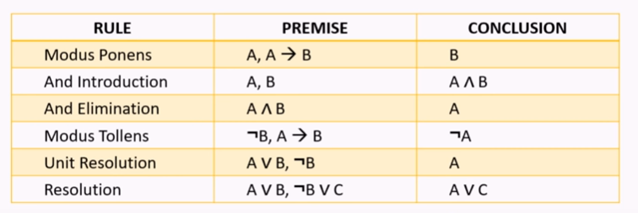
Rules of Inference
Rules of inference: logically valid inference patterns
Notes:
26

Slide 27
Rules of Inference
Addition ( ∨ Introduction)
If p is true, then 𝑝∨𝑞 is true,
Premise: 𝑝="It is raining
Conclusion: 𝑝∨𝑞 ="It is raining or the sun is shining
Notes:
27

Slide 28
Rules of Inference
Simplification ( ∧ Elimination)
If p∧q is true, then p is true
Premise: 𝑝="It is raining
Conclusion: 𝑝∨𝑞 ="It is raining or the sun is shining
Notes:
28

Slide 29
Rules of Inference
Hypothetical Syllogism (Chain Rule)
If 𝑝→𝑞 and 𝑞→𝑟 are both true,
then 𝑝→𝑟 is true.
Premise 1: 𝑝→𝑞 = "If it rains, the streets will be wet”
Premise 2: 𝑞→𝑟= "If the streets are wet, driving will be dangerous.”
Conclusion: 𝑝→𝑟="If it rains, driving will be dangerous”
Notes:
29

Slide 30
Rules of Inference
Disjunctive Syllogism ( ∨ Elimination)
if p∨q is true and ¬𝑝 is true, then q is true.
Example:
Premise 1: 𝑝∨𝑞="Either it is raining or the sun is shining.“
p∨q= "Either it is raining or the sun is shining.“
Premise 2: ¬𝑝="It is not raining.
"Conclusion: 𝑞="The sun is shining
Notes:
30

Slide 31
Thank You

